Slide 1

DATA ANALYTICS IN HOSPITALITY DOMAIN USING PYTHON
Presented by
R.Ramachandran

Slide 2
ATLIQ GRAND
AtliQ Grands owns multiple five-star hotels across India.
They have been in the hospitality industry for the past 20 years.
They Provide excellent service, luxurious accommodations and high comfort

Slide 3
AtliQ Grand
Bangalore
Delhi
Hyderabad
Mumbai
AtliQ Property
Standard
Elite
Premium
Presidential

Slide 4
Problem Statement
Due to strategic moves from other competitors and ineffective decision-making in management, AtliQ Grands are losing its market share and revenue in the luxury/business hotels category
As a strategic move, the managing director of AtliQ Grands wanted to incorporate “Business and Data Intelligence” to regain their market share and revenue.

Slide 5
Data Collection
dim_date.csv
dim_hotels_csv
dim_rooms.csv
fact_aggregated_bookings.csv
fact_bookings.csv

Slide 6
Data cleaning and Data Transformation
Invalid guest records with negative values were removed.
Removed outliers in revenue generated for accurate and using statistical functions like mean and standard deviation in Python proceeding with cleaned data.
A new column has been introduced to calculate Occupancy Percentage. It reflects the utilization of available rooms.
Combining Relevant Datasets for a better view.

Slide 7
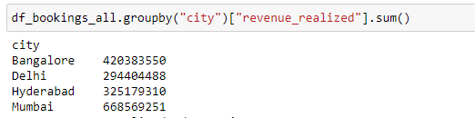
1.What is revenue realized per city
Mumbai generates highest revenue

Slide 8
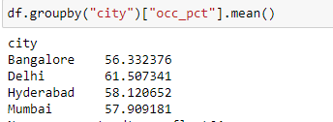
2.What is average occupancy rate per city
Delhi has high average occupancy rate || Bangalore has low average occupancy rate

Slide 9
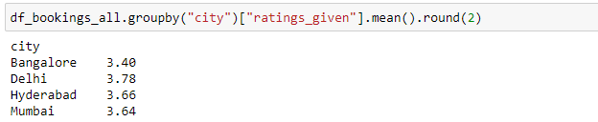
3.What is average rating per city
Delhi is highest average rating per city

Slide 10

4.When was the occupancy better? Weekday or Weekend?
Weekends show high occupancy rate compared to Weekday

Slide 11
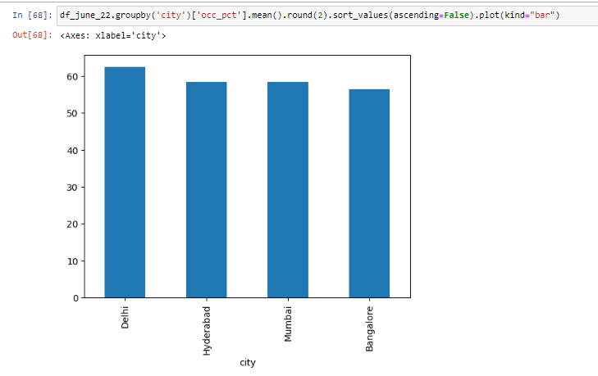
5.In the month of June, what is the occupancy for different cities
In the month of June, Delhi is high occupancy rate

Slide 12
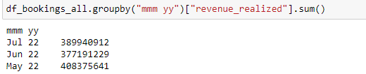
6.What is month by month revenue
In Year 2022 July month generated high revenue

Slide 13
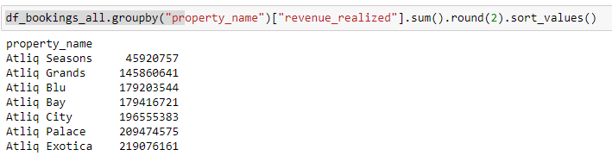
7. What is revenue realized per hotel type
Atliq Exotica hotel generates highest revenue

Slide 14
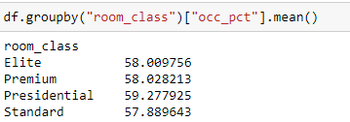
8.What is an average occupancy rate in each of the room categories?
Presidential rooms have highest average occupancy rate

Slide 15
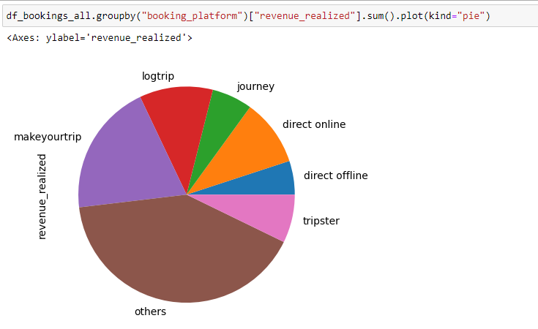
9. Show a pie chart of revenue realized per booking platform

Slide 16




THANK YOU

